Slide 1
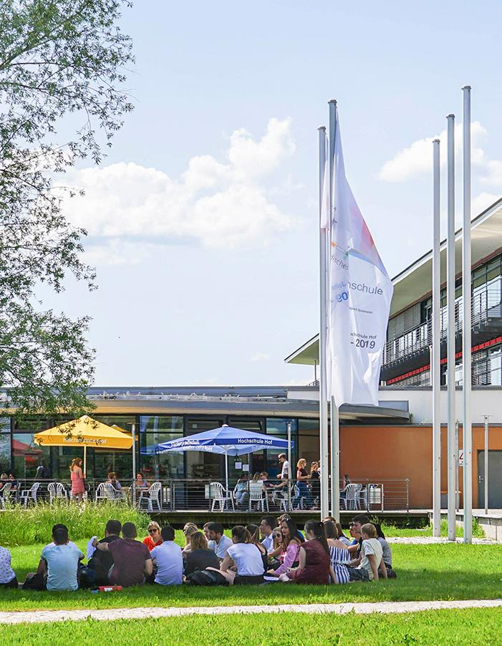
Vegetation Health Maps
via
DJI Pro Mini 4
Berkay Gök | Group 3

Slide 2
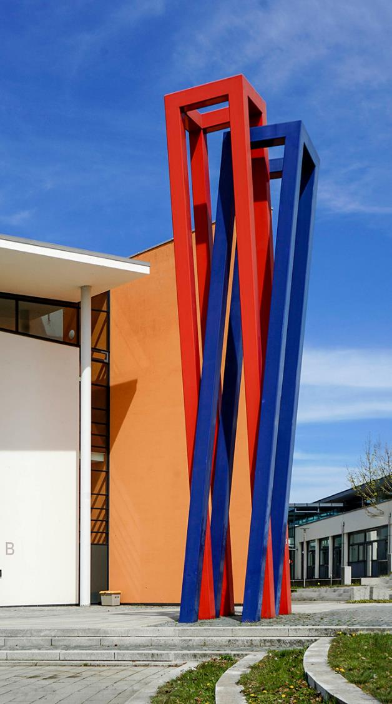
Agenda
Problem & Business | 3-4
Tools | 5
Overview | 6
System Architecture | 7
Project Structure | 8
Setup & Dependencies & Usage | 9
Model Details | 10
Outputs | 11
Web Portal | 12
RTMP | 13
Validation & Results | 14
Contributors | 15
End | 16

Slide 3

Problem
Checking vegetation health by hand takes a lot of time and effort hard for farmers to notice problems early, like dry areas or plant stress
Satellite images are not detailed enough and not always available when needed
Our Idea
Use drones with image analysis to check vegetation health quickly and accurately
Turn complex data into simple visual maps that are easy to understand
Let users see the results through a simple web-based interface
Notes:
We planned to stream the drone video using RTMP with Nginx, but it did not work in practice
To avoid blocking the project, we used YouTube streaming instead (Then, web portal)
During the flights, the drone sometimes stopped in the middle of the mission
This happened because the altitude was set too high
Also, the automatic landing was not always reliable
In some situations, the drone could land too close to obstacles like trees

Slide 4
Business
How We Start Selling
Pilot projects with small farms or test fields
Offer a low-cost first flight to show clear value
Use the results as proof for future customers
How We Make Money
Pay-per-flight for occasional monitoring
Seasonal subscription (e.g. once per month during growing season)
Reports & recommendations as an add-on
Who It’s For
Farmers who want to detect problems early
Agricultural companies managing large areas
Environmental and land-monitoring organizations

Slide 5






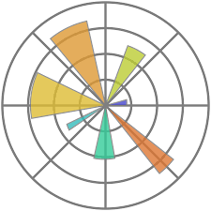

Tools
Data Preparation
Numpy
- Enables fast, efficient numerical computing with multidimensional arrays.
Pandas - Library for data-relevant tasks like data preprocessing and transformation
Utilities
Folium - Library that helps you create several types of Leaflet maps
Branca - Lightweight Python library for generating HTML + JS pages
Nginx - Open-source web server software used for reverse proxy, load balancing, and caching
PyAv - Pythonic binding for FFmpeg
Modeling
Opencv - Library of Python bindings designed to solve computer vision problems
Scikit-learn
- Open source machine learning library that supports supervised and unsupervised learning
Joblib
- Open-source library for the Python programming language that facilitates parallel processing, result caching and task distribution
Matplotlib - Library for visualization of data

Slide 6



Overview
This project implements a complete data processing pipeline for generating Vegetation Health Maps from drone video footage. It processes raw video and SRT metadata to calculate health indices (like VARI, ExG, TGI) using a Pixelwise Machine Learning Model (SGDClassifier).

Slide 7
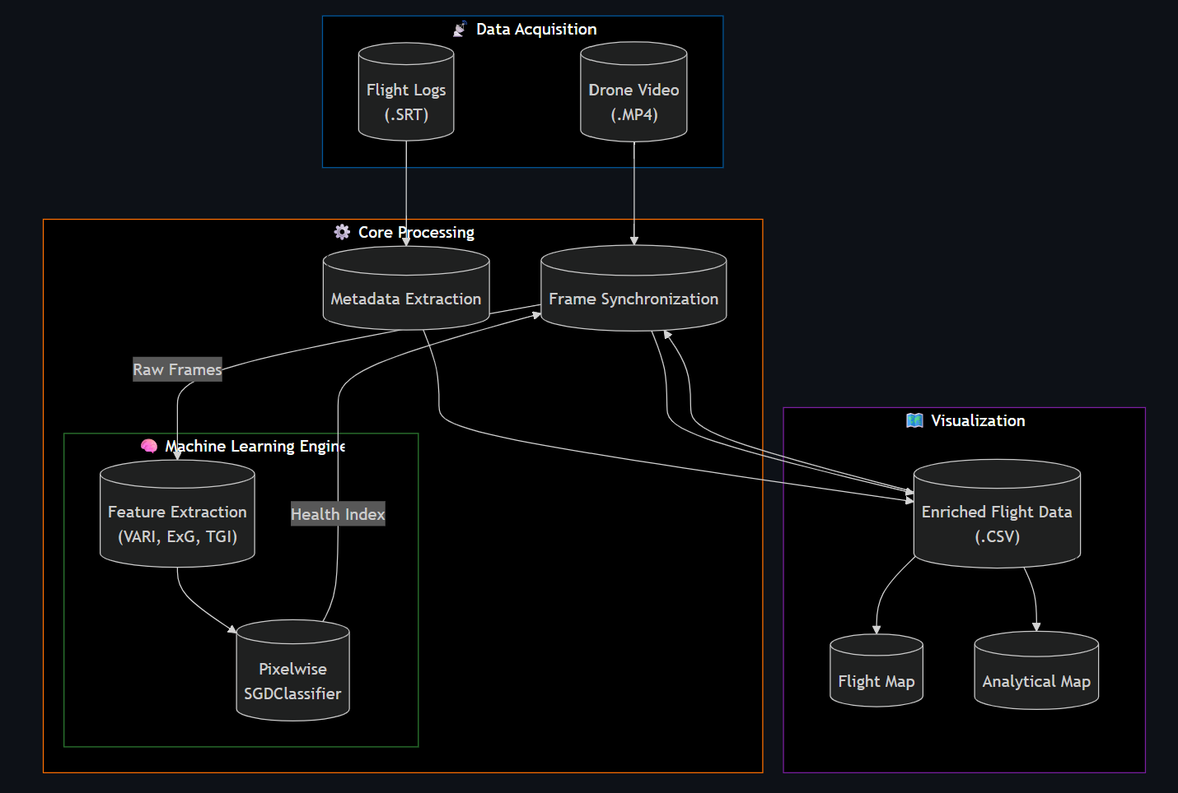
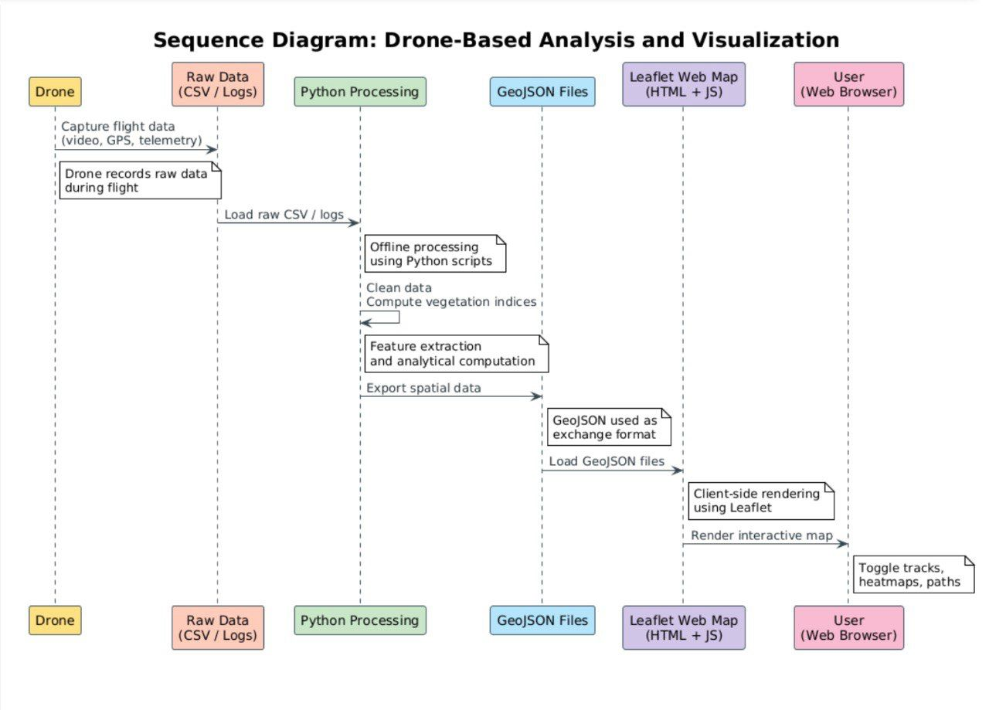
System Architecture

Slide 8

Project Structure
The workspace is organized modularly:
main.py
maps/
analytical_map
flight_map
datasets/
PlantVillage/
DatasetDrone/
Flights/
src/
ingestions/
models/
processing/
visualization/
data/
models/
processed/

Slide 9
Usage
You can run the entire pipeline or individual steps using main.py.
Run Full Pipeline To process all flight data found in datasets/flights/ and generate maps:
Individual Steps
Train Model (if needed) Trains the SGDClassifier using PlantVillage and Drone date
Extract Metadata Parses .srt files from datasets/flights/ into CSVs in data/processed/
Calculate Health (Sync) Applies the trained model to video frames,adding health indices
Generate Maps #Generates flight path map #Generates health heatmap
python main.py pipeline
Setup & Requirements
python main.py train
Environment: Ensure you are using the project's virtual environment.
Dependencies:
opencv-python
numpy
pandas
scikit-learn
joblib
folium
branca
Matplotlib
Nginx
pyAv
python main.py extract
source venv/bin/activate
python main.py sync
python main.py map-flight
python main.py map-analytical

Slide 10
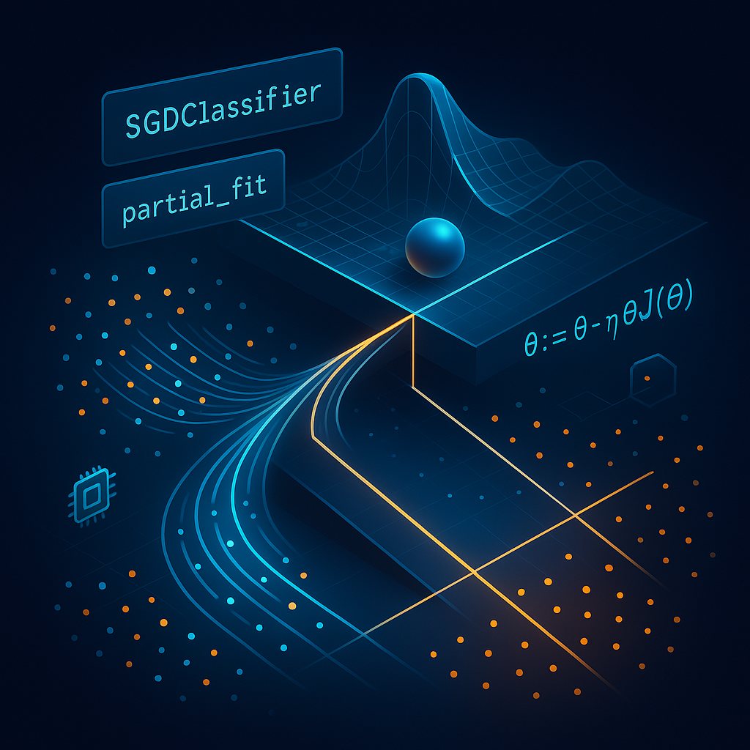
Model Details
Type: SGDClassifier (Stoachastic Gradient Descent)
Features: Pixel-level extraction of:
VARI (Visible Atmospherically Resistant Index)
ExG (Excess Green)
TGI (Triangular Greenness Index)
Training Data: Mixed dataset of PlantVillage (labeled leaves) and DatasetDrone (drıne frames with weak labeling)
*https://medium.com/@juanc.olamendy/sgdclassifier-the-powerhouse-for-large-scale-classification-9ae2369d57fb

Slide 11
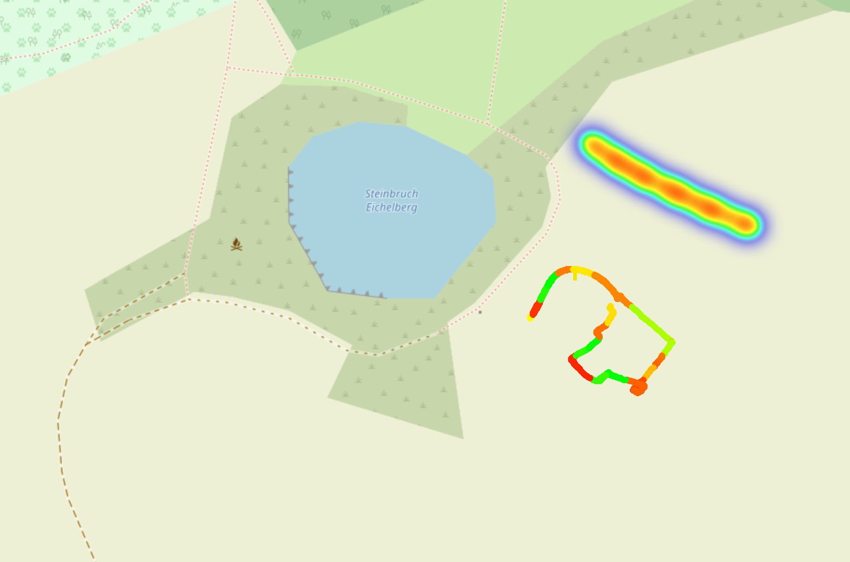
Outputs
After running the pipelinei find your maps in maps/:
maps/flight_map.html: Shows the drone’s path and altitude.
maps/analytical_map.html: Interactive Health Map containing
Global Heatmap: Interpolated view of vegetation health (Green=Healthy, Red=Unhealthy
Per-Track Layers: Toggleable layers for individual flights, showing heatmap, specific points, and flight paths.
Satellite Base: Esri World Imagery background.

Slide 12
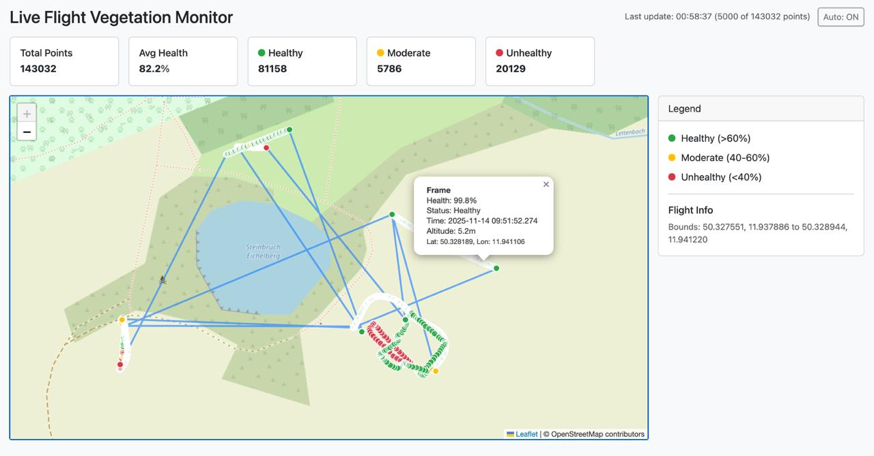
Web Portal
System Development & Implementation
Data Processing Engine: We developed a backend using Python, OpenCV, and NumPy to automate the calculation of vegetation indices from raw RGB imagery.
Geospatial Mapping: The portal uses Leaflet and OpenStreetMap to visualize flight paths and georeferenced data points in real-time.
RGB-Based Analytics: By utilizing visible spectrum indices like VARI, ExG, and TGI, we eliminate the need for expensive multispectral hardware Operational Impact
Precision Agriculture: Provides a low-cost, high-resolution health map to identify nutrient deficiencies or dehydration.
Targeted Action: Enables farmers to perform targeted irrigation or fertilization based on spatial variations shown in the unhealthy (red) zones.

Slide 13
RTMP
RTMP Protocol & Connectivity
Intended Real-Time Stream: The project originally aimed to use the RTMP (Real-Time Messaging Protocol) to broadcast live 4K video from the DJI Mini 4 Pro directly to a processing server.
Technical Constraints: Due to latency and stability limitations in achieving 100% real-time autonomous processing, the workflow was optimized to prioritize data integrity through our Web Portal.
Data Bridge: RTMP remains the primary protocol used to transfer captured video frames from the field to the ground station for rapid analysis.
https://dl.djicdn.com/downloads/DJI_Mini_4_Pro/DJI_Mini_4_Pro_User_Manual_EN.pdf

Slide 14
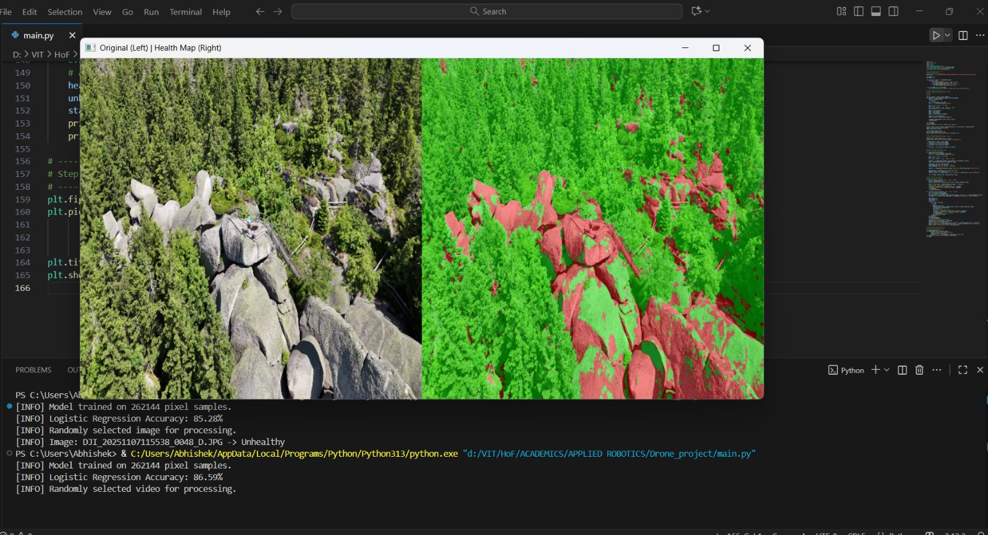
Validation & Results
Visual Proof (Segmentation) The model successfully differentiates between healthy vegetation (Green) and non-vegetation/stressed areas (Red/Black), specifically ignoring dirt paths.
Quantitative Accuracy
Evaluated on 6,200 unseen images (Test Set)
Figure: Left - Original Frame; Right - Health Mask Overlay.
Metric | Score | Note
Accuracy | 83.1% | Overall correct classification
Disease Recall | 94.0% | Ability to detect unhealthy plants
Note: Our model is designed as a pessimistic detector (High Recall for Unhealthy), prioritizing the detection of potential issues over minimizing false alarms.

Slide 15
Contributors
Member | Role | Key technical Contribution
Matheus | Lead & Integration | Pipeline Architecture, Sync Logic, Validation Scripts
Zihad | Mapping (Fronted) | Leaflet/Folium Visualization, UX/UI, Custom CSS
Berkay | Mapping (Backend) & Drone Usage Leader & General Debugger | IDW Interpolation Logic, Color Scale Algorithms
Yevhenii | Streaming | RTMP Architecture Design, Latency Profiling
Sultan | Hardware/Ops | Lab Testing, GPU Environment, Video Link Validation
Roma | QA/Testing | System Robustness Testing, Demo Recording
Abhishek | ML Optimization | SGDClassifier Hyperparameters, Model Explainability
Aditya | Data Engineering | Dataset Curation, Normalization Pipelines
Aseem | Analytics | Validation Metrics, Error Analysis

Slide 16
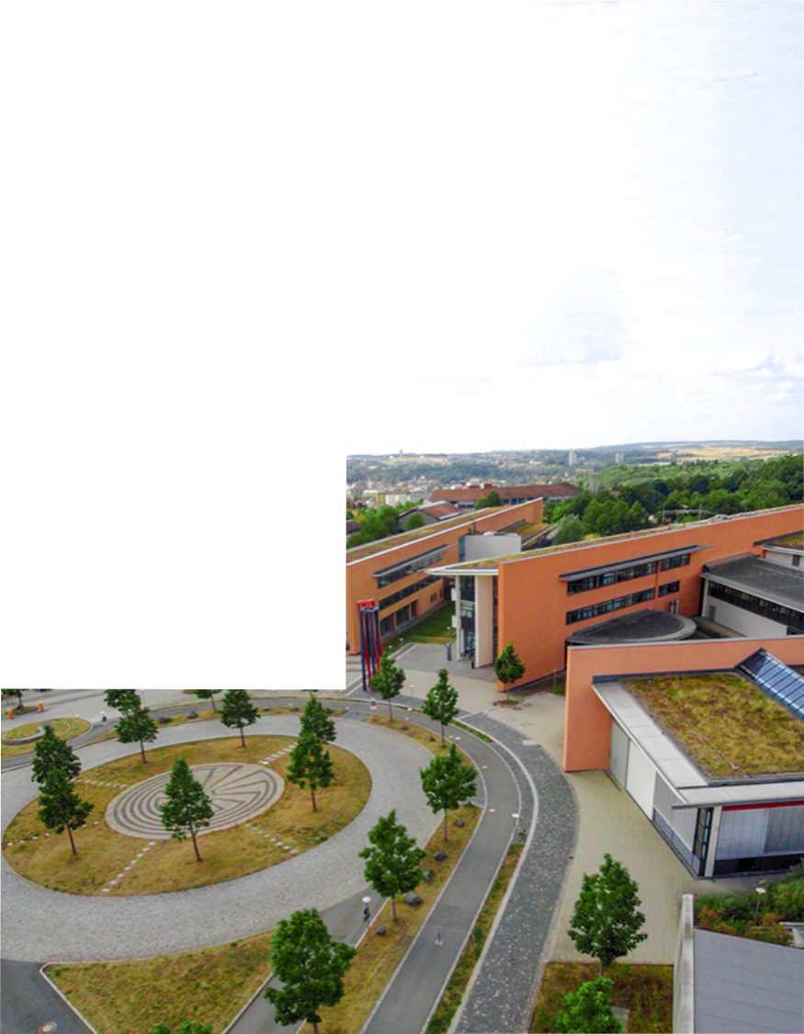
The End
95028 Hof
Alfons-Goppel-Platz 1 Phone +49 1522 399-0183
bgoek@hof-university.de www.hof-university.de

